Slide 1
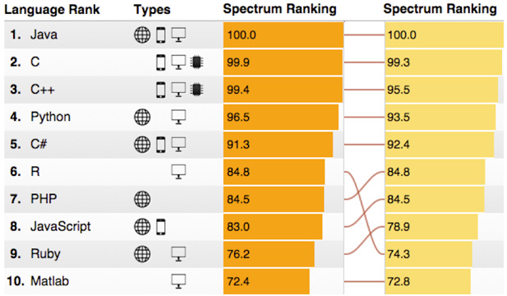
IEEE Spectrum rating for programming languages, 2014-2015

